Slide 1
Supervised Learning Methods for Drilling State Prediction Proposal
Prepared by Nicole McCarthy
For Deere Development Company, LLC.
May 30, 2025

Slide 2
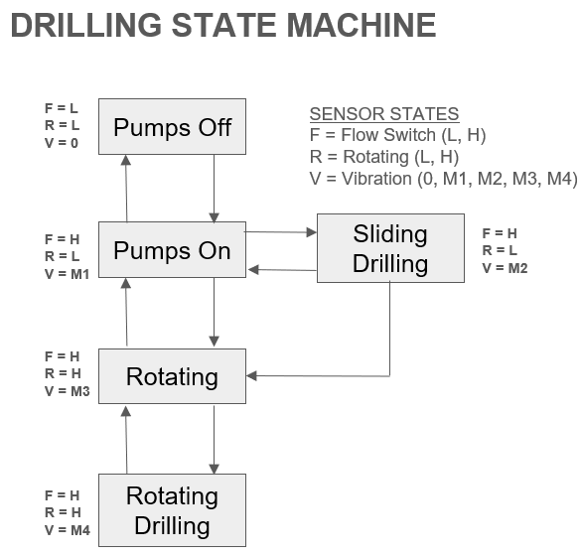
The Problem
Software on drilling tools can be optimized by knowing what state the tool is in
Deere Development Company (DDC) has outlined the Drilling State Machine seen here to fulfill their software needs
Indicating Drilling Parameters
Flow
Rotation
Vibration
Weight on Bit (WOB)

Slide 3
The Data
Well | Run | Date In | Date Out | MD In | MD Out
Flybar 1 WB | Run 7 | 12/2/2024 | 12/4/2024 | 10582 | 13222
 | Run 8 | 12/4/2024 | 12/8/2024 | 13222 | 17880
Flybar 1 WC | Run 6 | 12/9/2024 | 12/10/2024 | 10175 | 10287
 | Run 7 | 12/10/2024 | 12/11/2024 | 10287 | 10713
 | Run 8 | 12/11/2024 | 12/12/2024 | 10713 | 12088
Flybar 2 WC | Run 5 | 11/23/2024 | 11/28/2024 | 10960 | 16782
Provided by DDC from real runs on oil rigs
Includes the following items:
Time
Depth
Gallons per Minute (GPM) (Flow)
RPM (at Motor and Surface)
Axial and Lateral Vibration (at Motor and Pulser)
Weight on Bit (WOB)

Slide 4
Related Previous Work
Prediction Goals
Torque Downhole
Geological Formations (porosity and permeability)
Drilling Parameters Used
(Varying by Study)
Rate of Penetration (ROP)
RPM
GPM
Strokes per minute
Torque
WOB
Time
Depth
Hook Load
Most Accurate Methods
(not all tested methods shown here)
Decision Trees (DTs) and Random Forests (RFs)
Support Vector Machines (SVMs) with Just-In-Time Learning (JITL)

Slide 5
Proposed Work
In order of priority:
10 Decision Trees
Each will include WOB and aggregate flow parameters
One will include all possible parameters provided
Nine will be variations of rotation and vibration parameters and their averages
Random Forest of previously mentioned DTs
Support Vector Machines for Flow, Rotation, Vibration, and WOB
Combined into one drilling state
Just-In-Time Learning application to SVMs (for increasing efficiency and accuracy)

Slide 6
Evaluation
Train on Flybar 1WB and 1WC
Test on Flybar 2WC
Statistical Analysis
Mean Absolute Error
Accuracy (Including a Confusion Matrix)
1 Run
5 Runs in Total

Slide 7
Current Status and Challenges
Most preprocessing complete
- Data understood fully
- Almost ready to move on to modeling
Largest challenge is time constraints
- Prioritized methods to build and test
- Update coming on June 11 for progress

Slide 8
Conclusion
Project to be completed by end of June
Methods of building and testing prioritized:
DTs (10)
RF
SVMs
JITL addition
Evaluated for error and accuracy
Completion will allow for better implementation of MWD software
Leading to more cost effective, safe, and time efficient drilling techniques

